Slide 1

Health Insurance Data Analysis and reporting Using SQL Database and Power BI Tool

Slide 2










Trusted Full IT Services Partner since 2010
WHO WE ARE
50+ Clients, 3000+ projects delivered across US, UK, Canada,
Australia, India and ASEAN
550+ career engineers based out of US and India
Centers of Excellence into all Service areas and New Technologies
Mobile Devices and IOT Labs
ISO 27001 and ISO 9001 External surveillance
audit and renewals
CMMi Level 3 – DEV 2.0 Certified
Comply with SOC 2 – Type II
Comply HIPAA regulations
ISO 27001: 2013 | ISO 9001:2015
| CMMi Level 3 certification | SOC2 Certified| HIPAA Certified
24/7 NOC Support
Irving TX, US | Hyderabad, India
MotivityLabs © Copyright 2022. All Rights Reserved.

Slide 3
SERVICES OVERVIEW
PRODUCT ENGINEERING
DEVOPS/CLOUD
ROBOTIC PROCESS AUTOMATION
Custom Application Development
Integration between Applications
Application/ Cloud Migrations
Mobile Application Development
App Support & Maintenance
All Cloud platform support (AWS, Azure, GCP)
Continuous Integration
Continuous Deployment
Continuous Testing
Continuous Monitoring
Continuous Feedback
Kofax
UiPath
Automation Anywhere
Blue Prism
QUALITY ASSURANCE
DATA SCIENCE/ENGINEERING
ENTERPRISE SECURITY
Functional Testing
Compatibility Testing
Localization Testing
Compliance Testing
Test Automation
Web Services/APIs
Load Testing & Capacity Assessment
Predictive Analysis
BI Architecture
R Language
Python
Data Modelling & Warehousing
Data Mining
ETL
Custom Dashboards
Configuration & Migration
Advanced Threat Management
Cyber and Infra Security
Identity and Access Management
Governance, Risk and Compliance
Center of Excellence (CoE): Continuous research, Dedicated labs, Accelerators, Value additions

Slide 4

OUR EXPERTISE
PRODUCT ENGINEERING
PROJECT MANAGEMENT
TOGAF Certified
Full Stack Developers
Cloud Practitioner & Architects
Big Data Platform Architects
PMSPC 5.0
SAFE Agilist
Certified Scrum Master
Lean Six Sigma
P, PMI-ACP
DEVOPS/CLOUD
ENTERPRISE SECURITY
CEH – Certified Ethical Hacker
OSCP – Offensive Security Certified Professional
CISSP - Certified Information Systems Security Professional
AWS – AWS Certified Security
AWS Certified Professionals
Azure Certified Professional
MCSE
RHEL
DATA ENGINEERING
Microsoft Certified: Data Analyst
Tableau
Power BI
QUALITY ASSURANCE
ISTQB Certified Engineers
Certified Information Systems Security Professional

Slide 5
PROBLEM STATEMENT
Client data is available in CSV files on web, which are converted into excel to prepare the reports using MS-Excel. It incurring huge amount of time to prepare reports manually because of large quantity of data and due to manual intervention, the error rate was high. So , the business is looking to Automate the reports using SQL Database and Power BI Desktop.
Current Data flow
RAW FILES ON WEB
(csv)
EXTRACTING EXCEL FILE MANUALLY
PREPARING EXCEL REPORTS MANUALLY

Slide 6
Solution: SQL server on-premises solution
Our solution: SQL server on-premises solution
First, we cleanse the data and load it into a data-warehouse in SQL Server then import the data into reporting tool for visualization.
For reports to be generated, we will use Power BI tool.
Data-flow diagram:
EXCEL FILES
Load to
SQL
DATABSE
Import To
POWER BI
DESKTOP

Slide 7
Use Cases
Health Insurance is looking to integrate raw data in to MSSQL Server Database to generate data driven reports .
Analyzing Hospital level wise Total policy Information
Identifying different Surgeries and amount spent on surgeries
Gender wise analysis in health insurance policies
Location wise and category wise policy and amount information

Slide 8
SCOPE
IN-SCOPE
Data Loading,
Data Cleansing,
Data Transformations
Data Visualization

Slide 9
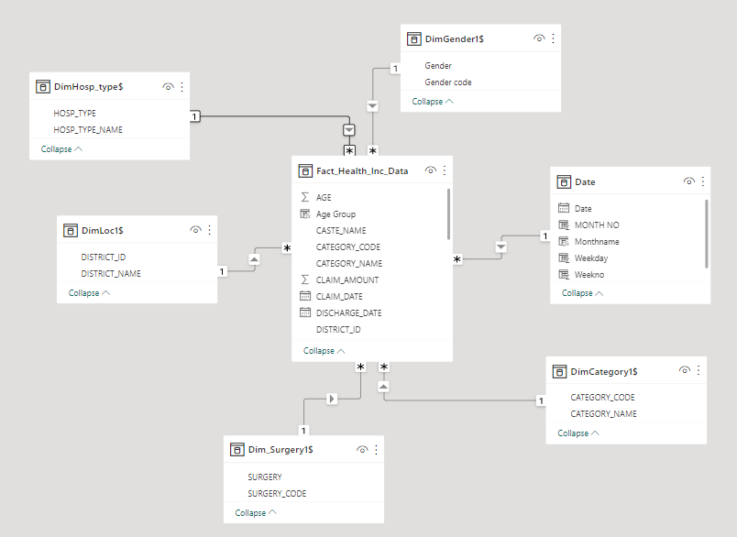
E-R Diagram for Data-Model
This is a sample proposed E-R diagram based on the Star schema where all dimension tables are connected to a single fact table
Dimension tables: Each dimension table has dimension attributes with start date, end date & flag with active or inactive
Example of Dimension table: Dim Surgery, Dim Category, Dim Gender, Dim Hosp Type, Dim Loc
Fact table: All these dimensions are formed a fact table.
Example Of Fact Table : Fact Health Inc Data

Slide 10
Power BI Reports

Slide 11
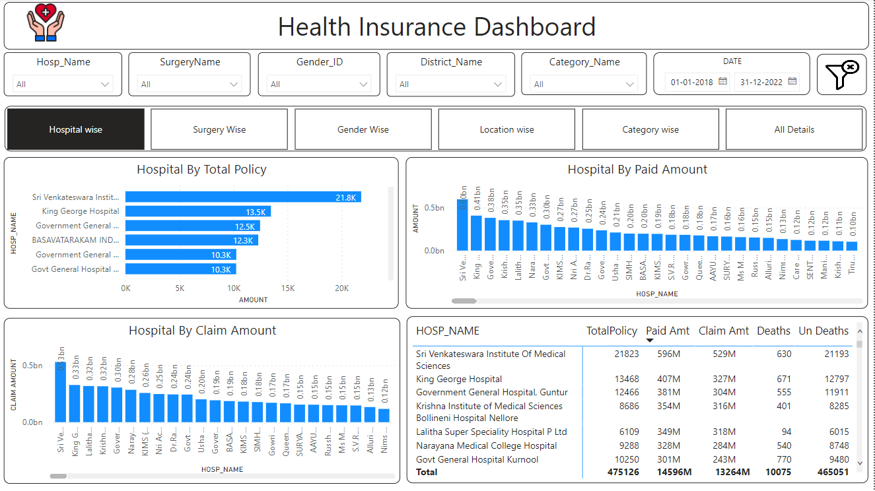
Hospital Name wise Report
Analyzing Hospital level wise Total policy, Amount and claim Information
For Data Visualization I used Clustered bar chart, Clustered column chart, slicer , card, Table and etc

Slide 12
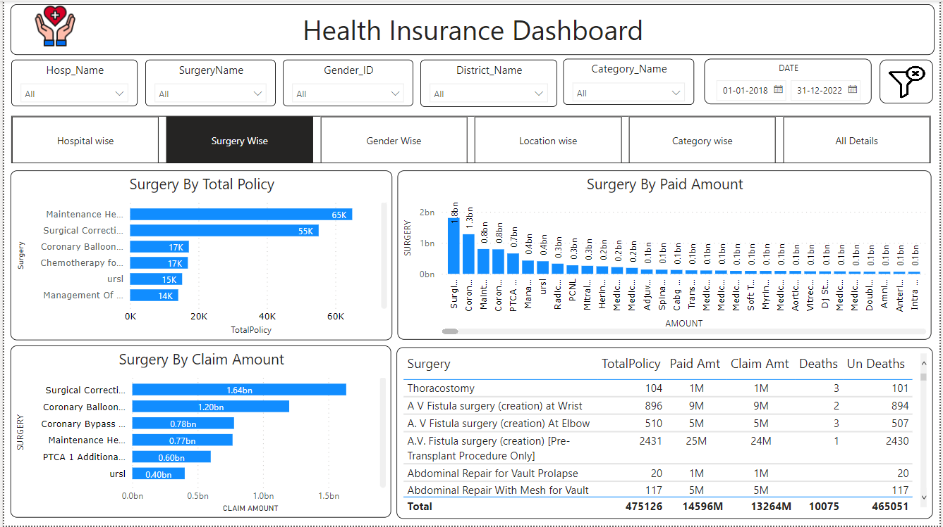
Surgery Name wise Report
Identifying different Surgeries and the amount spent on surgeries
For Data Visualization I used Clustered bar chart, Clustered chart slicer , card, Table chart and etc

Slide 13
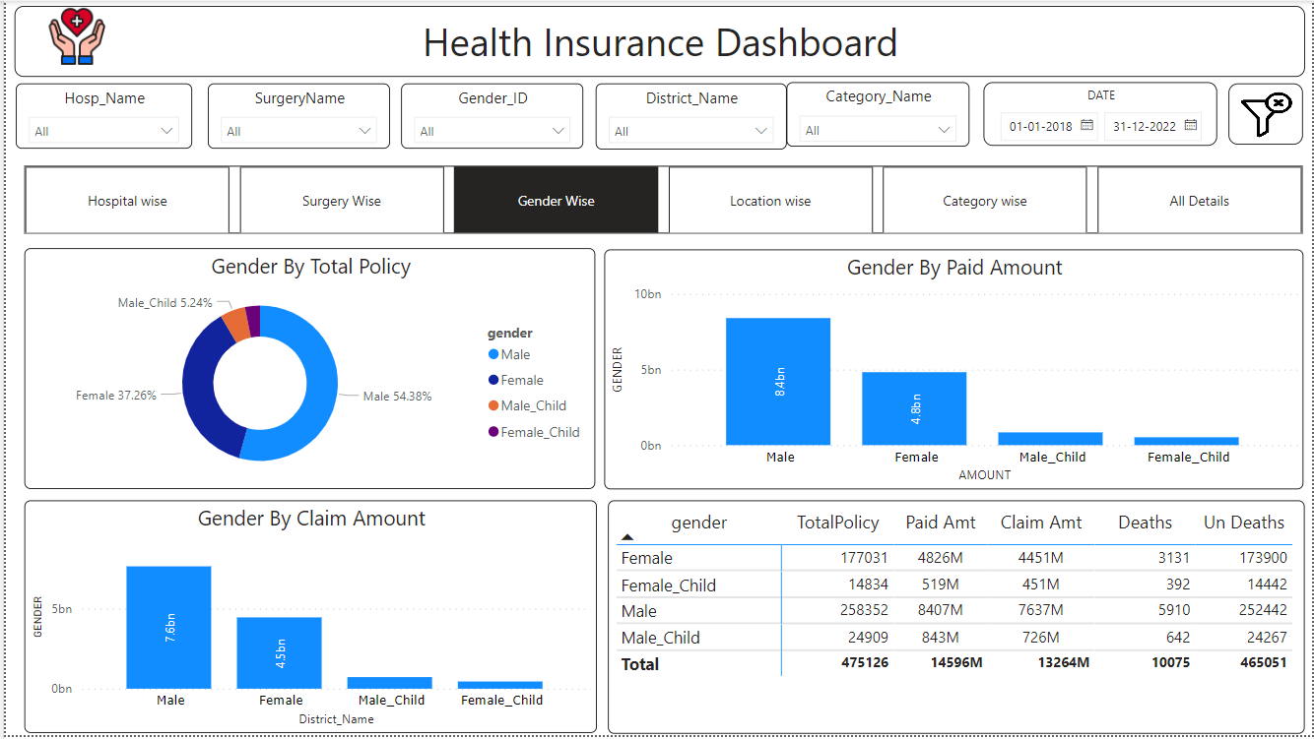
Gender wise Report
Gender wise analysis in health insurance policies
For Data Visualization I used, Clustered column chart, slicer, card, donut chart, Table chart, etc

Slide 14
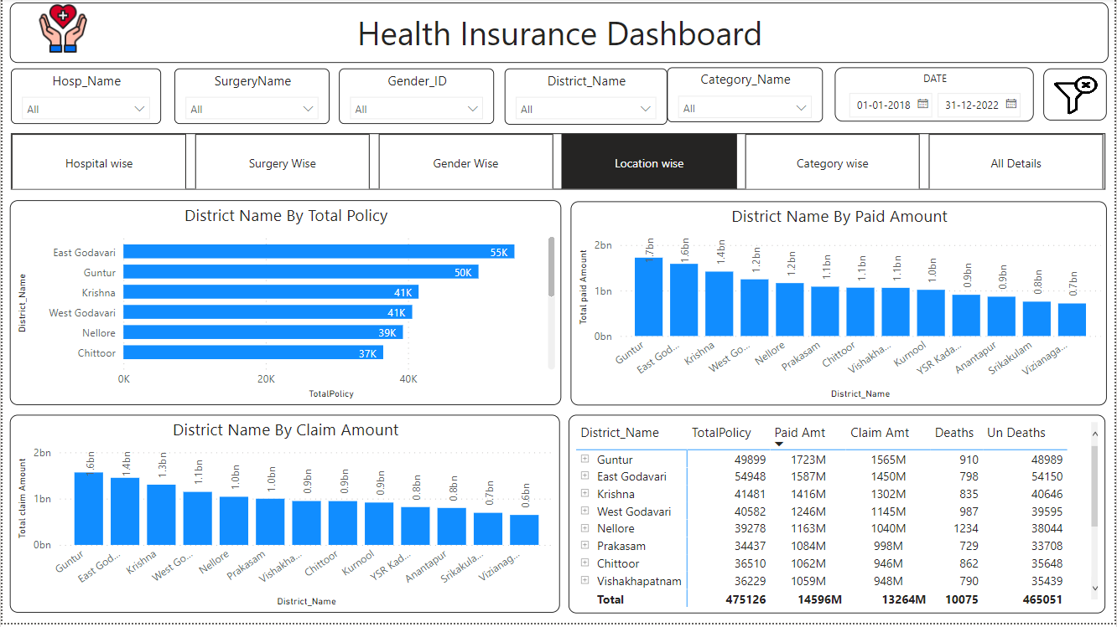
Location Wise Report
Location wise policy and amount information
For Data Visualization I used, Clustered column chart & Clustered bar chart, slicer, card and Table chart and etc

Slide 15
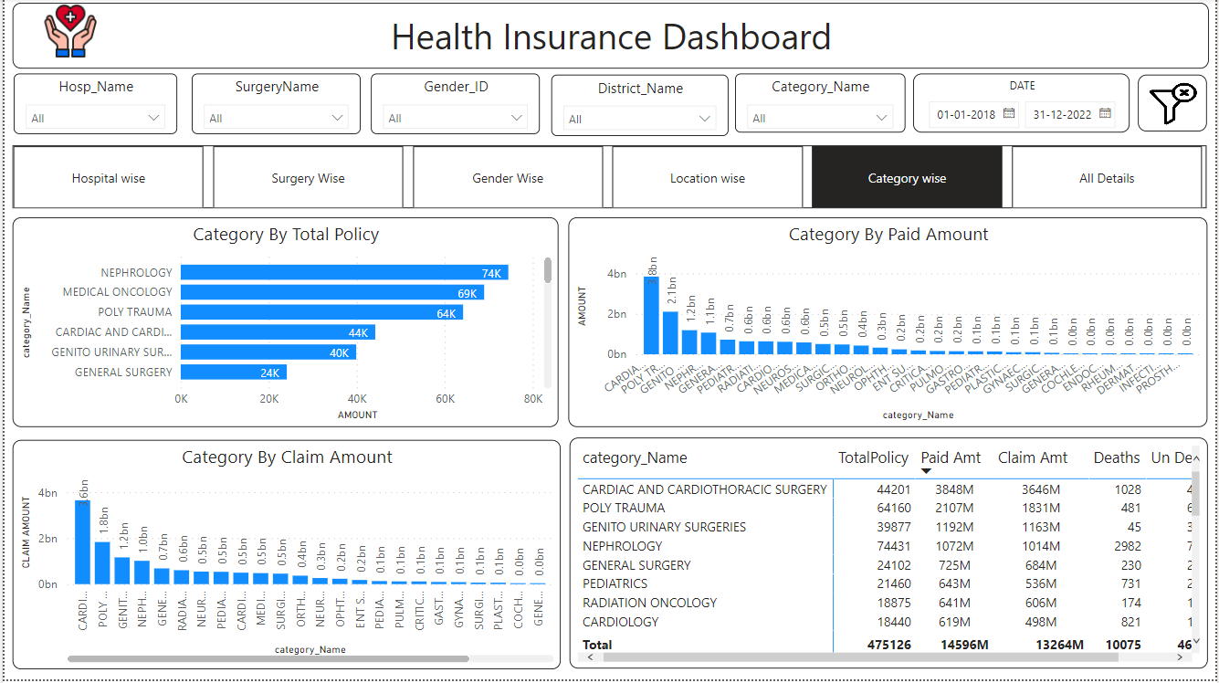
Category wise Report
Category wise Total policy and amount information
For Data Visualization I used, Clustered column chart & Clustered bar chart, slicer, card, Table chart and etc

Slide 16
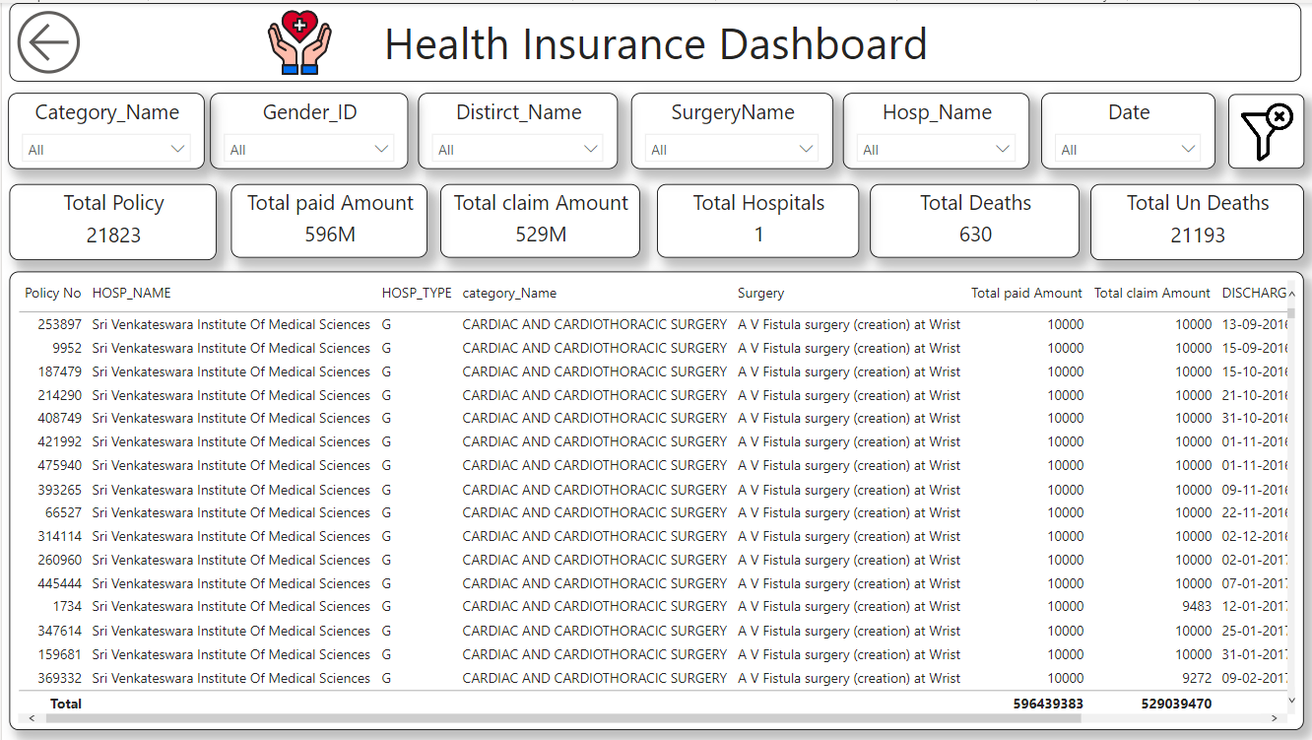
Health Insurance Detail Info Report
For Data Visualization I used slicer, card, Filter image, Table chart, etc

Slide 17
Low-Level and High-Level Design Document links
1.Low-Level Design overview.pptx
2.High Level design document Format.docx

Slide 18
THANK YOU

